Slide 1
Final Presentation
Team B

Slide 2
Project Description
The city of Boston is seeking a report on the characteristics of animal-related complaints submitted through the city's 311 app. This report should cover the volume of complaints, types of animals involved, specific areas where such complaints are frequent, and any patterns related to these complaints, such as seasonal and time variations & weather conditions.

Slide 3
Q1: How many reports were filed in the previous 2-3 years and 5-10 years, and are there any discernible trends in these reports, such as increases or decreases in total numbers?

Slide 4
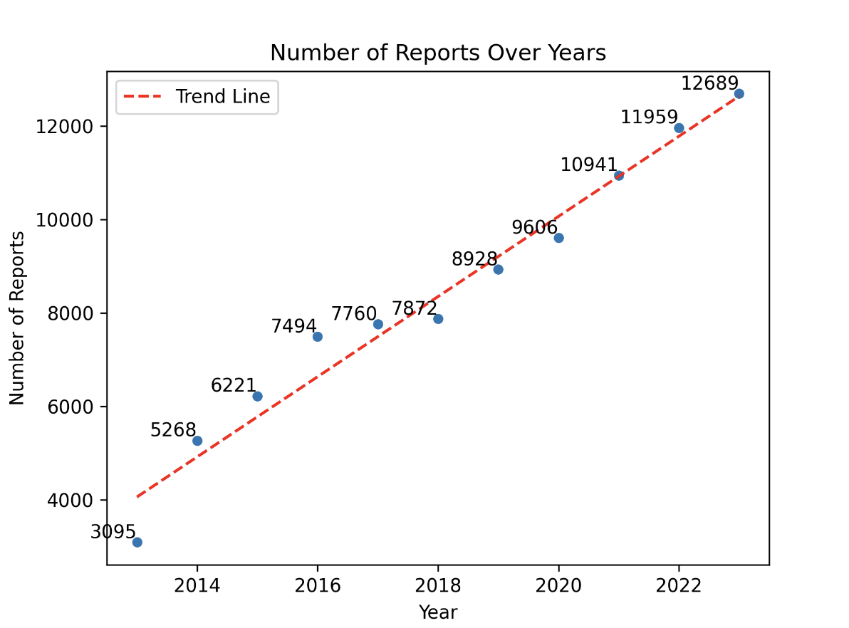
Figure 1: Portrays a clear ascending trend in animal-related complaints in Boston from 2013 to 2023, with a trend line highlighting the steady increase in reports over time.

Slide 5
Key Insights for Q1
Increased public awareness and accessibility to reporting mechanisms
Improvements in technology and ease of reporting may encourage more individuals to report animal encounters
Urbanization and changes in land use patterns
Could result in greater human-wildlife interactions
Environmental changes
Habitat loss
Alterations in wildlife behavior due to climate variability

Slide 6
Q2: What types of animals are most commonly reported in complaints?

Slide 7
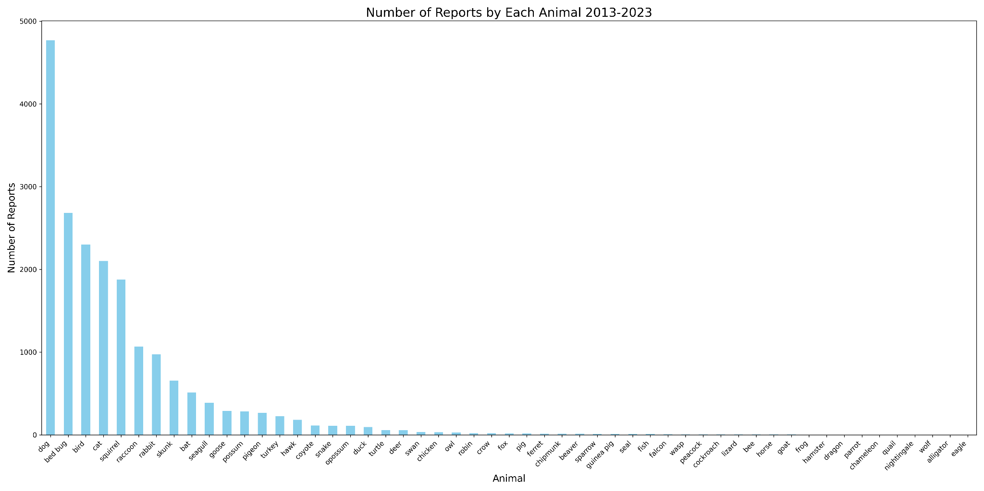
Figure 2: Illustrates the frequency of animal-related complaints, highlighting dogs, bedbugs and birds as the most commonly reported issues over the selected time frame.

Slide 8
Key Insights for Q2
Signals a pressing need for more targeted dog control and public health strategies
Potentially aid the city of Boston in several ways:
Resource Allocation
Public Health Initiatives
Urban Planning

Slide 9
Recommendations for Q1 and Q2
Targeted responses
Dogs: leash laws and waste disposal
Bedbugs: pest control initiatives, guidelines for landlords and homeowners to combat infestations
Resource planning
Consistent rise indicates the need for more resources dedicated to animal control and public health
Develop long-term strategies to address the root causes

Slide 10
Q3: Where are the complaints coming from geographically? Is there any trend to type of animal complaint and area?

Slide 11
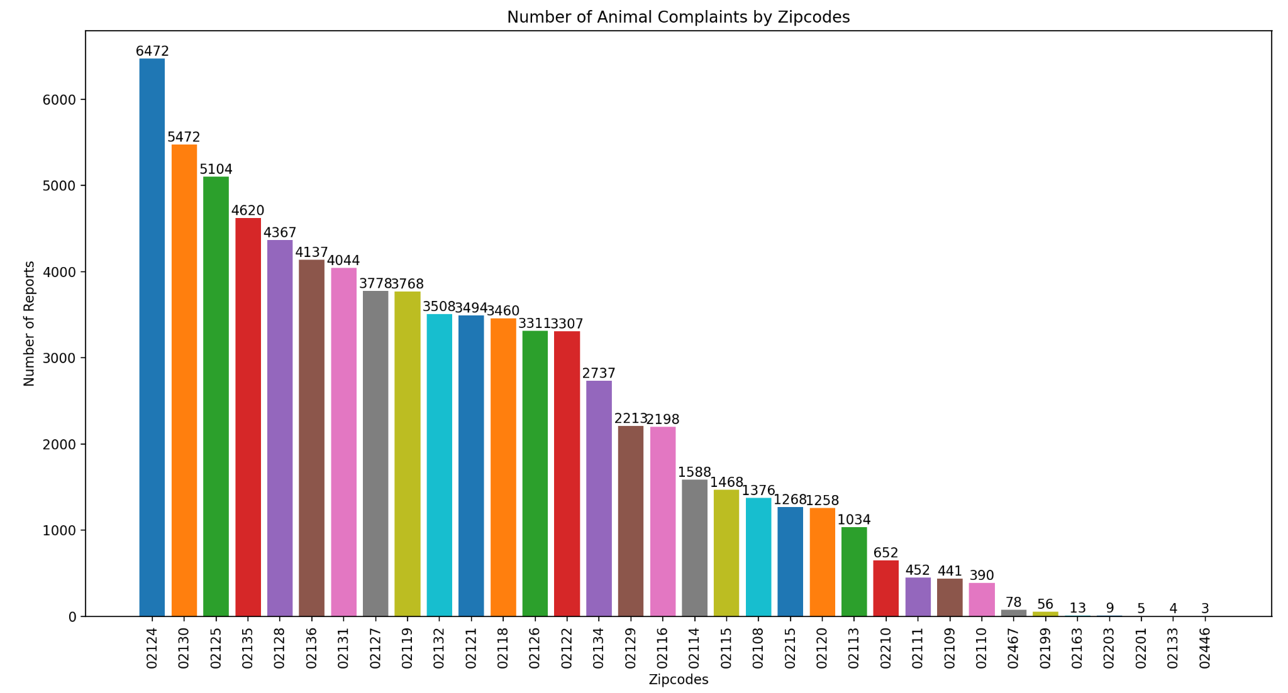
Figure 3: The bar chart of animal complaints by zip code reveals a significant variation ranging from a high of 6,472 in the 01224 area to a low of 3 in the 02446 area.

Slide 12
Top 5 Zip Codes:
02124: 6472 reports | Most Common Complaint: 'Pick up Dead Animal' with 2721 complaints.
02130: 5472 reports | Most Common Complaint: 'Pick up Dead Animal' with 2713 complaints.
02125: 5104 reports | Most Common Complaint: 'Pick up Dead Animal' with 2473 complaints.
02135: 4620 reports | Most Common Complaint: 'Pick up Dead Animal' with 2114 complaints.
02128: 4367 reports | Most Common Complaint: 'Pick up Dead Animal' with 1843 complaints.
Notes:
Drastic difference from when we split it by neighborhoods because the top neighborhood was Dorchester: 15972 reports: Most Common Animal Complaint: 'Pick up Dead Animal' with 7437 complaints. Which is different with the top zipcode witht he most amount of complaints

Slide 13
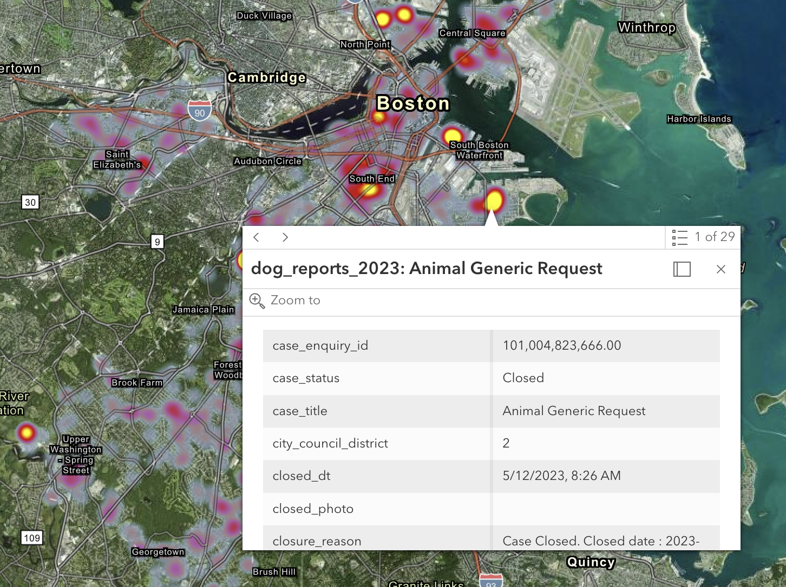
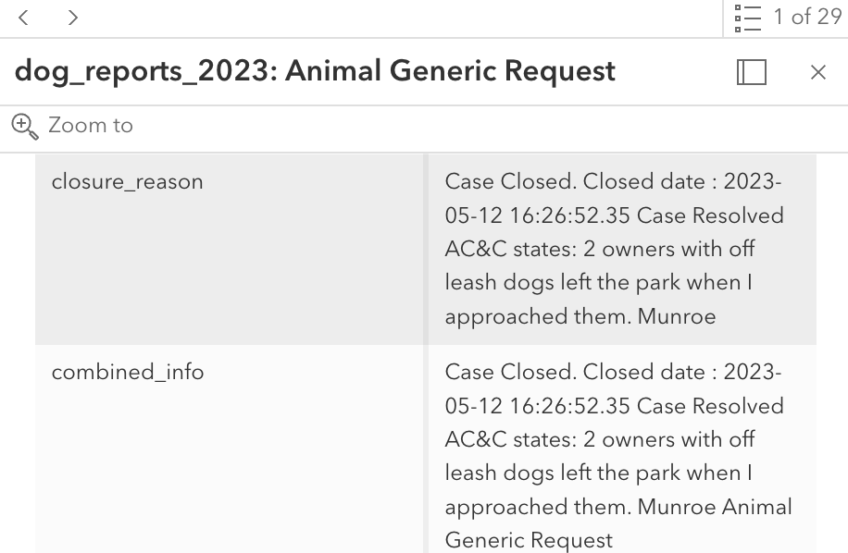
Interactive maps - https://arcg.is/1H0ea9
Notes:
Allows you to interactively click on points within the maps and see all the info pertaining to the incidents that happened in that spot (in the example i clicked on theres 29 incidents and you can toggle between them)

Slide 14
Key Insights for Q3
High Density Areas
More prone to issues requiring animal control services
Animal Carcasses
Widespread issue requiring city attention
Zip codes with lower frequency of complaints
Lower population of animals, better animal control measures, or fewer residents reporting in those areas

Slide 15
Recommendations for Q3
Resource Allocation
Allocate more resources, such as animal control officers and cleanup crews, to zip codes with more complaints
Public Awareness
Inform the public about responsible pet ownership, road safety to prevent animal accidents, and the importance of reporting dead animals
Investigate Underlying Issues
High traffic, proximity to natural habitats, or other factors?

Slide 16
Q4: How do other factors such as season impact the nature of the complaints?

Slide 17
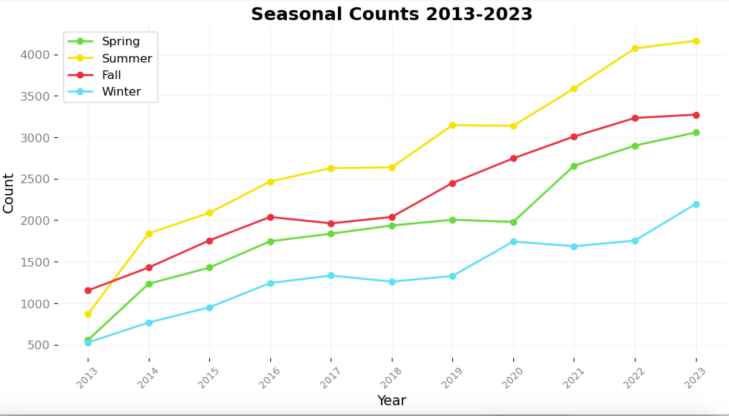
Figure 4: Seasonal variation in counts from 2013 to 2023, with spring consistently having the lowest counts and summer showing the highest, indicating a possible correlation between seasonality and the recorded metric.

Slide 18
Key Insights for Q4
Peak during Summer
Higher activity levels for both humans and animals
Lower number of complaints in Spring
Animals coming out of hibernation or less human outdoor activity in the early part of the season
Breeding season in Spring or early Summer
Visibility and accessibility in colder months
Snow and ice in winter might obscure carcasses
Difficult for residents to access areas where they might encounter animal issues

Slide 19
Recommendations for Q4
Preventative measures
Plan ahead for summer surges in complaints
More animal control staff during this season
Season-specific educational campaigns
Educate the public on how to handle animal encounters and when to report them
Habitat management
Habitat management strategies to prevent negative human-animal interactions

Slide 20
Extension Q1: How does the time of day impact the nature of the complaints?

Slide 21
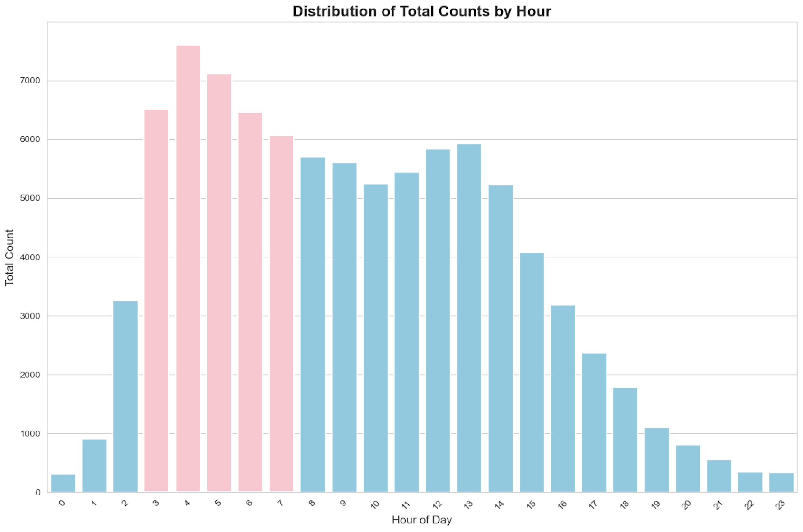
Figure 5: Display the number of complaints made at different hours throughout the day.

Slide 22
Key Insights for Extension Q1
Morning Peak
Correlates with increased human activity and the visibility of animals
Potentially correlated with presence of street cleaners/trash collectors active during these hours who are aware of and utilize 311
Midday Lull
Reduced animal activity or less human notice due to workday engagements
Evening Uptick
People engage in evening routines and pets are more active
Nighttime Quiet
Fewer interactions with animals or lower reporting due to people being indoors

Slide 23
Recommendations for Extension Q1
Public Worker Engagement
Implement ongoing training and awareness programs for all city workers who are likely to encounter animals during their shifts
Smart Lighting in Key Areas
Implement smart lighting solutions in areas with high nighttime animal activity that can deter animals from approaching inhabited areas
Urban Planning
Create urban planning decisions aimed to minimize human-animal conflict through better design of public spaces, waste disposal solutions, and green areas

Slide 24
Extension Q2: How does the proximity to parks and green spaces impact the animal-related complaints? Are there more animal-related complaints in areas closer to parks or green spaces within the city?

Slide 25
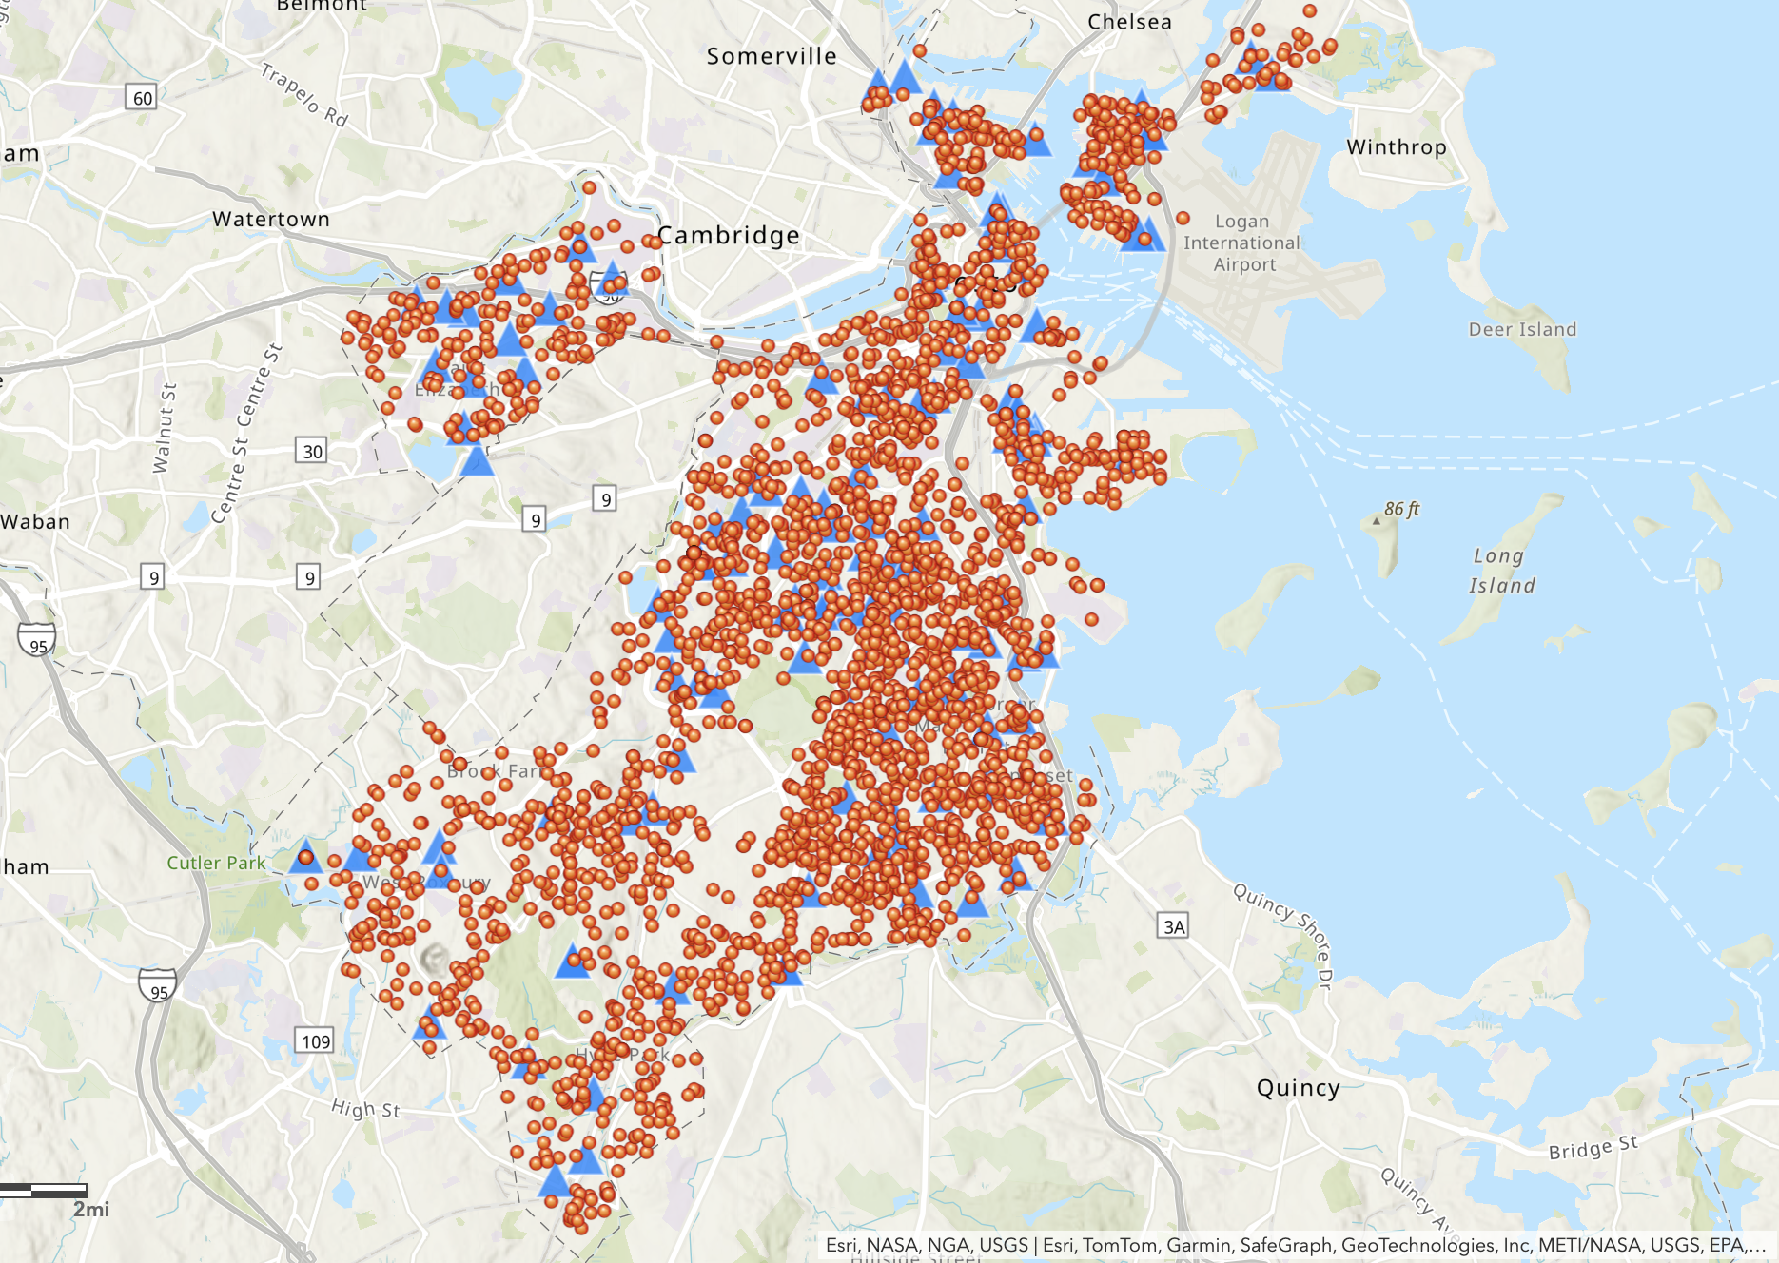
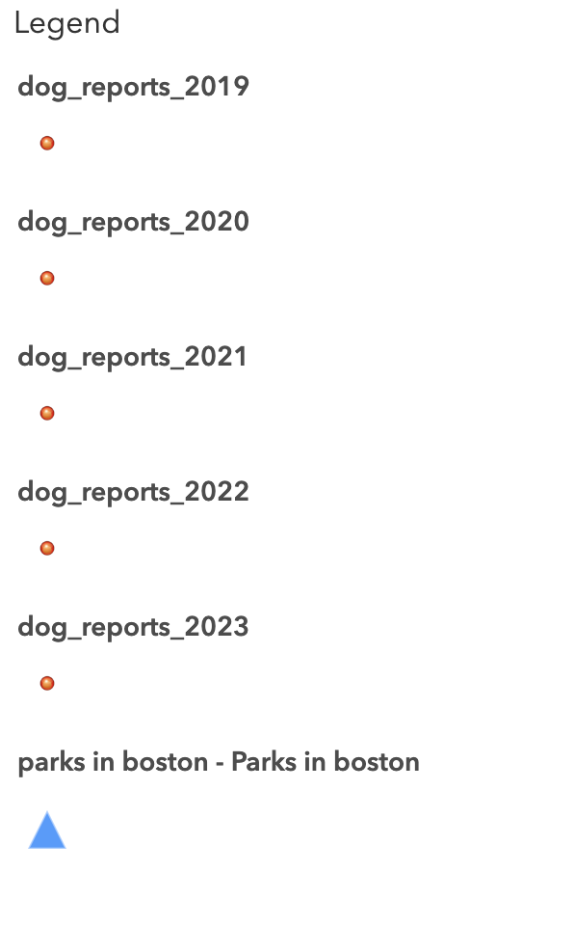
311 Reports with Parks in Boston

Slide 26
Key Insights for Extension Q2
Density of Reports Near Parks
Suggests a correlation between the proximity to parks and the number of animal-related complaints
Presence of green spaces may attract more wildlife or domesticated pets
Concentration in Urban Areas
Other factors such as population density or urban pet ownership rates might also influence the volume of complaints

Slide 27
Recommendations for Extension Q2
Improved Park Management
Implement or enhance park management practices that might include more visible signage, better fencing, designated off-leash areas, or stricter enforcement of existing regulations.
Comparative Analysis Between Parks
Factors such as the size of the park, the presence of off-leash areas, wildlife habitats, or the type of recreational activities permitted in the park might influence rate of incidents
Temporal Changes
Assess the reports over the years to show if increases or decreases may be related to changes in park management practices or the development of nearby areas

Slide 28
Limitations
Lack of Causal Analysis
While the graphs display trends and quantities, they don't provide reasons for these patterns
Importance of Demographics
Understanding variations in complaints across different areas might require demographic context
Possibility of Reporting Bias
Rising complaint numbers may indicate greater public engagement in reporting rather than an actual rise in incidents
Potential for Underreporting
Certain populations or areas may not report as frequently, skewing the data

Slide 29
Thank you!
Notes:
Surroinding envirment

